Slide 1
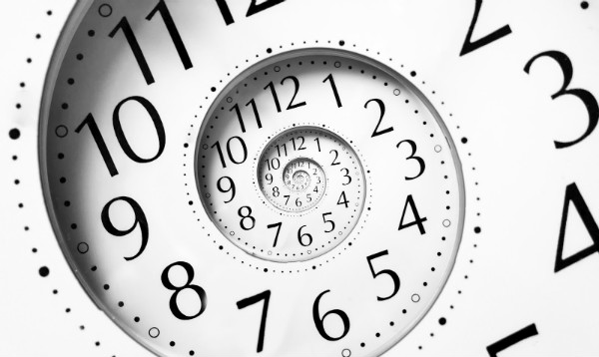
Logical Clocks

Slide 2
Definition:
A logical clock is a mechanism for capturing chronological and causal relationships in a distributed.
the order in which a series of events happened

Slide 3
Logical clocks in DS:
What is important is usually not when things happened but in what order they happened so the integer counter works well in centralized system.
However,in a DS ,each system has its own Logical clock and you can run into problems if one ‘clock’ gets ahead of others.

Slide 4
To order events across process,trying to sync clocks is one approach.
Another approach:Assign Timestamps to events.
As long as these timestamps obey casuality conditions this would work.

Slide 5
Happened Before Relationship
a
b
P
Ts(a)<Ts(b)
a
P1
b
P2

Slide 6
Properties derived from Happened Before Relationship
Transitive Relation
Casually Ordered Relation
Concurrent event

Slide 7
Transitive Relation:
If
Ts(a)<Ts(b)
Ts(b)<Ts(c)
Then
Ts(a)<Ts(b)

Slide 8
Casually Ordered Relation:
a>b
If a>b then any changes in a will effect the changes in b
So a should not be greater than b
Concurrent Event:
a>b a will not be occured before b
a<b b will not be occured before a
a||b Both a and b will be occured in parallel

Slide 9
Lamports logical clock:
Each process uses an local counter which is an integer the initial value of the counter is zero.
The process increment it’s counter when a send or receive instruction takes place.
The counter is assigned to the event as its Timestamp.
The send event carries its timestamp
For receive event, counter is update as
Max(local clock, msg timestamp) +1

Slide 10
ts=1 ts=2 ts=3 ts=5 ts=6
P1
ts=2
P2
ts=3 ts=4
P3
ts=1 ts=2 ts=7

Slide 11
Vector Logical clock:
Vector initialize to zero for each process.
Vi[i]=0 for I=1, 2,.....N
Increment vector before timestamp event
Vi[i]=vi[i]+1
Msg is sent from pics with Vi attached to it.
When Pj receives msg
Vj[i]=max(Vi[i], Vj[i]) for i=1... N

Slide 12
(1,0,0) (2,,0,0) (4,3,1) (5,3,1)
P1
(0,0,0)
(0,1,1)
P2
(0,0,0)
(2,2,1) (2,3,1)
P3
(0,0,0)
(0,0,1) (0,0,2) (5,3,3)

Slide 13


